Slide 1

Emotion Classification Using CNN for Facial Expression Recognition
Automatically identifying human emotions from facial expressions in real-time using deep learning.

Slide 2
Data Preprocessing Steps
Dataset Acquisition
Downloaded using Kaggle API and unzipped to /content/dataset.
Image Resizing
Uniform dimensions: 48x48 pixels.
Pixel Normalization
Scaled from 0-255 to 0-1 range.
Data Augmentation
Rotation, flipping for model robustness.
Label Conversion
Categorical format for multi-class classification.

Slide 3
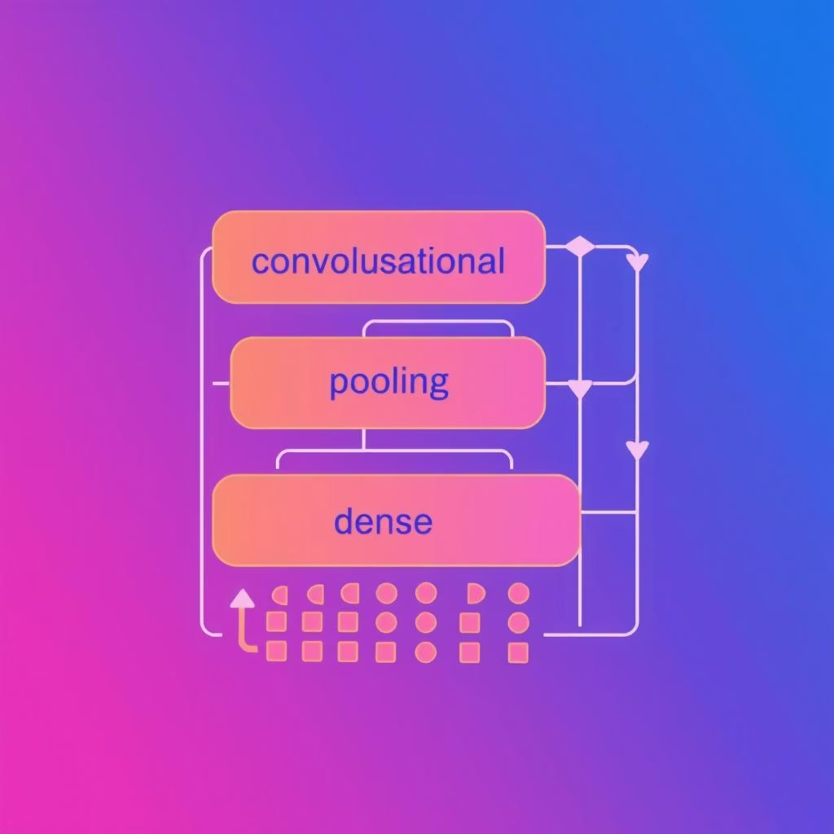





Methodology: CNN Approach
Model Choice
Convolutional Neural Network (CNN) using Keras.
Justification
Excels at spatial feature extraction.
Ideal for multi-class image classification.
Keras: flexible, rapid prototyping.
Architecture Overview
Convolutional Layers
With ReLU activation.
Pooling Layers
For dimensionality reduction.
Dense Layers
For classification.
Softmax Output
For multi-class probabilities.

Slide 4












Implementation Pipeline
Data Loading
Preprocessing
Images loaded via Kaggle API.
Resize, normalize, augment images.
Save Model
Model Building
Trained model saved as emotion_model.h5.
CNN defined with Keras.
Evaluation
Training
Validated on test set for accuracy and loss.
On labeled data with categorical cross-entropy loss.
Output: Model saved and downloadable via Google Colab.

Slide 5
Outcomes and Results
Model Performance
Deliverables
Trained CNN classifies emotions from face images.
Saved model: emotion_model.h5
Key metrics: Accuracy, precision, recall.
Code: Jupyter Notebook with full pipeline.
Challenges Faced
Handling class imbalance in emotion categories.
Ensuring generalization across diverse faces.

Slide 6
Final Report Summary
Problem
1
Classify human emotions from facial expressions.
Dataset
2
Kaggle Face Expression Recognition Dataset.
Preprocessing
3
Image resizing, normalization, augmentation.
Solution
4
CNN-based model in Keras.
Results
5
Functional model: emotion_model.h5.
Future Work
6
Advanced architectures, real-world data testing.

Slide 7



Code and Documentation
Code Package
Jupyter Notebook: emotion_classification_cnn_using_keras_(1).ipynb
Kaggle API setup
Data loading
Model training
Model saving
Documentation
Submission
Clear comments for reproducibility.
Fully functional code, downloadable model, and this presentation.
Structured report in presentation format.

Slide 8
How to Create and Download PPTX
1
Copy Content
Copy this markdown content.
2
Paste into PowerPoint
One section per slide.
3
Format & Visualize
Add headings, bullets, dataset images, CNN diagrams.
4
Save File
As Emotion_Classification_CNN_Presentation.pptx.
5
Download
Export from PowerPoint for presentation use.

